Slide 1

BIDARI EVENT 2025
A Celebration of Culture, Music & Unity
10–11 November 2025, Bidar

Slide 2
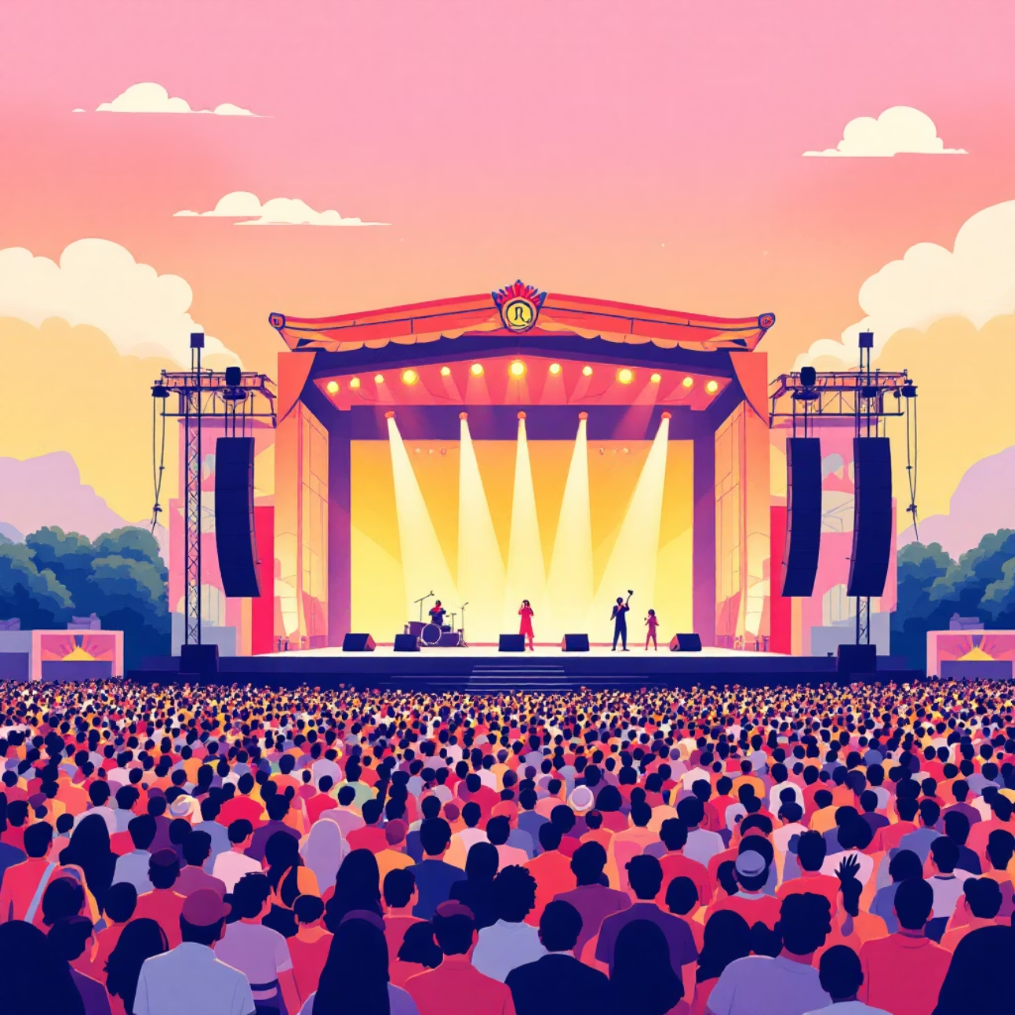
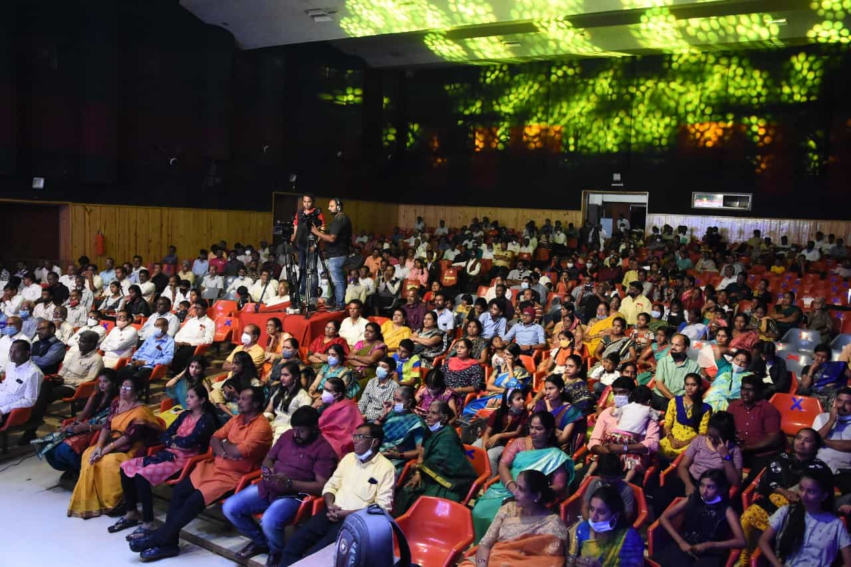
EVENT OVERVIEW
Igniting Bidar's Arts and Culture
A Two-Day Extravaganza
Massive 2-day cultural festival.
Expected attendance of 5,000+ enthusiastic attendees.
Featuring 4 headline singers and local cultural showcases.
Our Core Mission
The Bidari Event aims to promote the rich arts, music, and heritage of Bidar, bringing the community together through an unforgettable celebration.

Slide 3




The Impact: Who Attends Bidari?
Music Enthusiasts
Youth & Students
The primary draw: attendees seeking high-caliber live musical performances.
A high concentration of attendees aged 15–30 (45%), ideal for reaching younger demographics.
Families & Locals
Professionals
A significant family presence (20%) ensures broad community reach across generations.
Key audience segment (35% aged 31–50) with high purchasing power.
5K+
45%
35%
Day 2
Expected Footfall
Ages 15-30
Ages 31-50
Peak Attendance

Slide 4
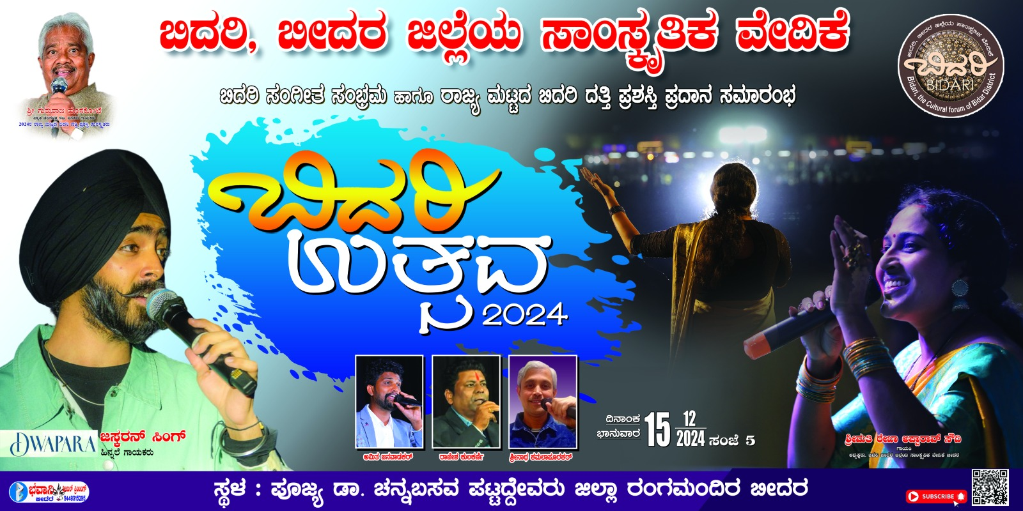
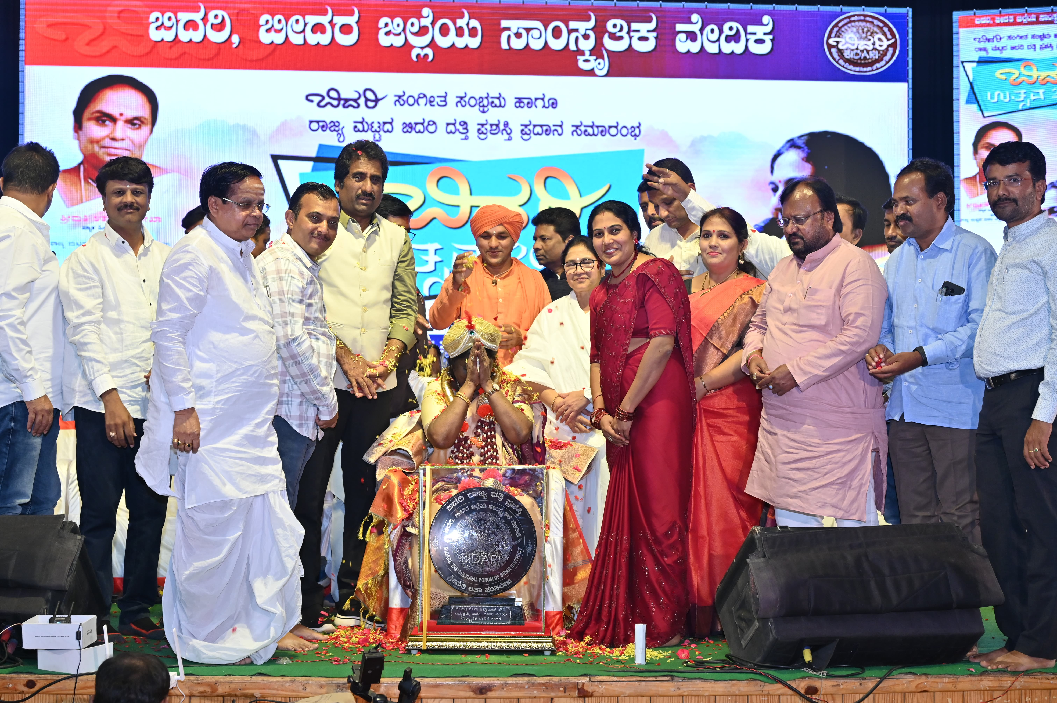
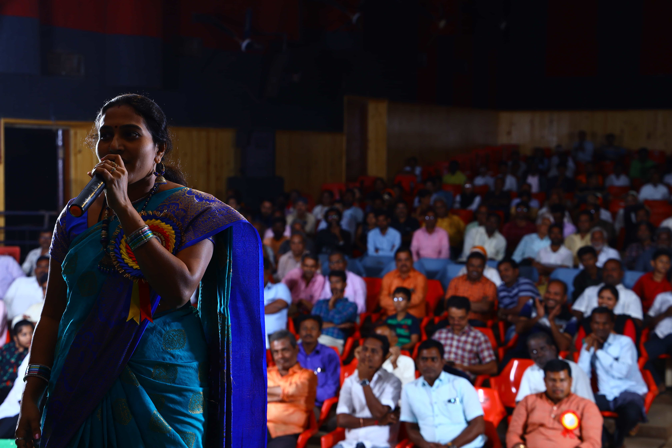
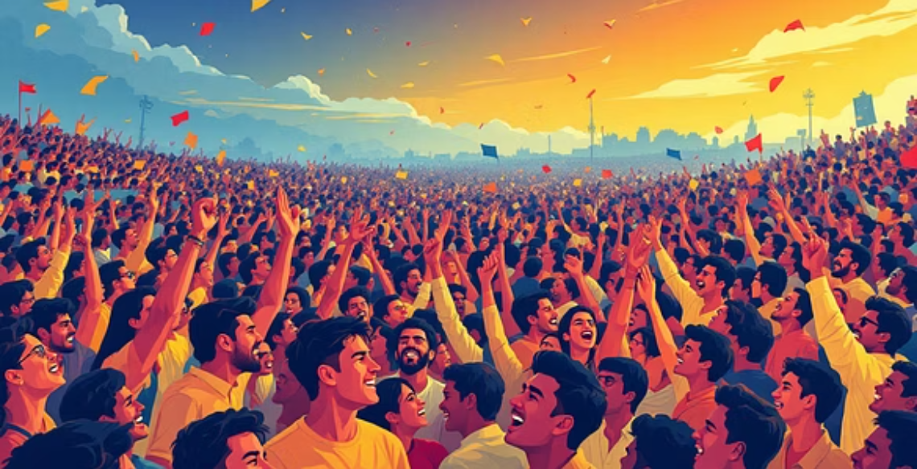
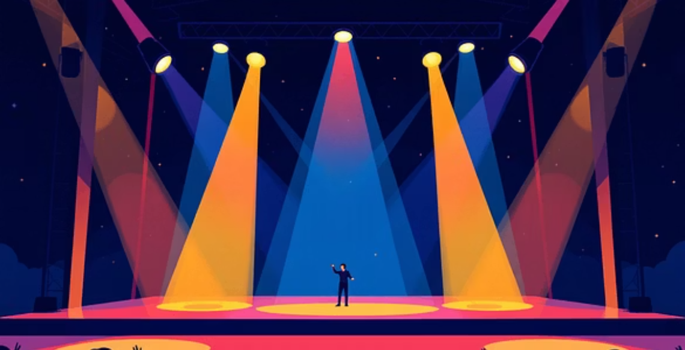
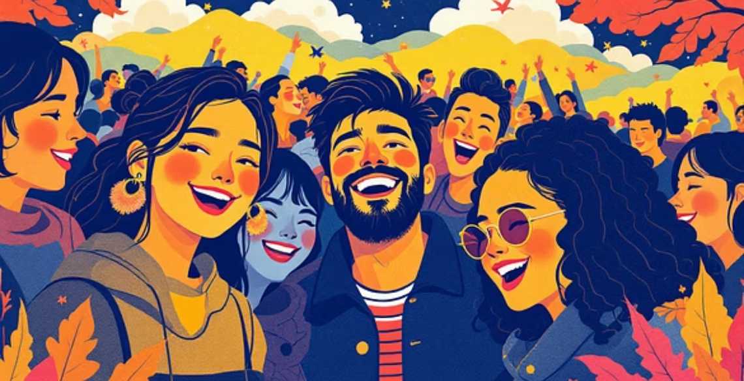


Building Credibility: Highlights From Past Events
Our commitment to quality has led to consistently growing attendance and high audience engagement year after year.
3,500 Attendees
Digital Reach
Recorded at Bidar Utsav 2023, showcasing strong growth momentum.
High engagement on YouTube highlights and social media channels. Watch Clips Here.

Slide 5





Elevating the Experience: What’s New in 2025
Grand Two-Day Format
Expanded festival featuring a massive grand finale celebration on Day 2 for maximum impact.
Four Famous Headliners
Securing four famous, high-profile singers to drive ticket sales and footfall.
Expanded Visual Coverage
We've added 6 smaller LED screens alongside the main stage LED for better visibility across the venue.
Premium Sponsor Zone
Dedicated VIP lounge and hospitality area for sponsors and special guests.
Branded Merchandise
50 branded gifts included in top packages for exclusive distribution.

Slide 6
Sponsorship Tiers: A Value Comparison
Choose the package that best fits your marketing goals and desired level of exposure.
Suggested Price
₹1,00,000
₹50,000
₹35,000
Title Rights/Co-presenter
Yes
No
No
Main Stage Logo Size
Largest
Medium
Shared Area
Screen Video Plays
2x (30–60s)
1x (20–30s)
None (side display only)
Prime Sponsor Stall
Prime Zone
Standard Zone
Outdoor
VIP Passes
10
5
2
Banners Across Bidar
Included (100 total)
Shared Placement
No
Dedicated Social Campaign
Yes
Included in Group Posts
Included in Thank You Post

Slide 7

GOLD SPONSOR: PREMIUM VISIBILITY
Maximum Exposure & Title Rights (₹1,00,000)
Exclusive Benefits
Title Rights: "BIDARI EVENT 2025, presented by [Your Company]".
Stage & Banner Dominance: Largest logo placement on stage and all 100 city banners.
Video Plays: Two premium 30–60 second video slots on the main LED screen during peak hours.
Venue Branding: Prime stall location, logo on entry passes, and watermark presence on 6 smaller screens.
Hospitality & Social: 10 VIP passes, stage felicitation during the finale, and a dedicated pre-event social media campaign.

Slide 8

ASSOCIATE & SUPPORTER TIERS
SILVER SPONSOR (₹50,000)
High brand recognition for mid-sized campaigns.
Medium-sized logo presence on main stage and shared city banners.
One 20–30 second video play on the main screen.
Logo inclusion on all 6 small screens and one dedicated banner zone at the venue.
5 VIP hospitality passes and multiple mentions by the emcee during the show.
BRONZE SPONSOR (₹35,000)
Affordable entry point for strong local engagement.
Logo displayed in a shared banner area at the venue entrance.
Included in the sponsor thank-you list in the event brochure and social posts.
Ability to place one banner outside the main event perimeter.
2 VIP passes for your team members.
Bronze tier is ideal for local businesses looking for cost-effective brand association.

Slide 9
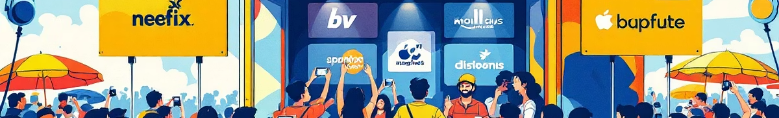
Digital & Physical Activation Plan
We deliver visibility across the full event lifecycle: pre-event hype, on-site engagement, and post-event analysis.
Pre-Event Marketing
Post-Event Deliverables
Social media posts and reels with sponsor tags to build anticipation.
Feature in the official event highlight video.
High-reach WhatsApp campaign and physical poster distribution across Bidar.
Thank-you posts and complete analytics report on footfall and digital reach.
During Event Activations
Branded selfie wall and charging stations.
Live event coverage shout-outs and sponsored lucky draws.
Branded wristbands distributed to all attendees.

Slide 10

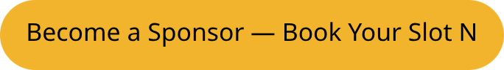




Secure Your Position for 2025
Investment, ROI, and Next Steps
Projected ROI & Reach
Limited premium slots are available. To secure Title or Day-2 exclusivity, please confirm your package immediately.
On-Site Impressions: Over 5,000 direct interactions during the two days.
Digital Reach: Estimated 50,000+ impressions across social media platforms pre and post-event.
Media Coverage: Featured clips in regional news and digital media broadcasts.
Contact Us Today
Phone: +91 XXXXXXXXXX
Email: bidarivedike@gmail.com

